Slide 1
CSYE 7280 - User Experience Design and Testing
Instructor: Vishal Chawla

Slide 2
Overview
What is human factors engineering?
What is Human-Centered Design, and
why do we need Human Centered Design?
Considering the limits of human performance.
Some examples of human-centered design.
Human-centeredness in design thinking

Slide 3
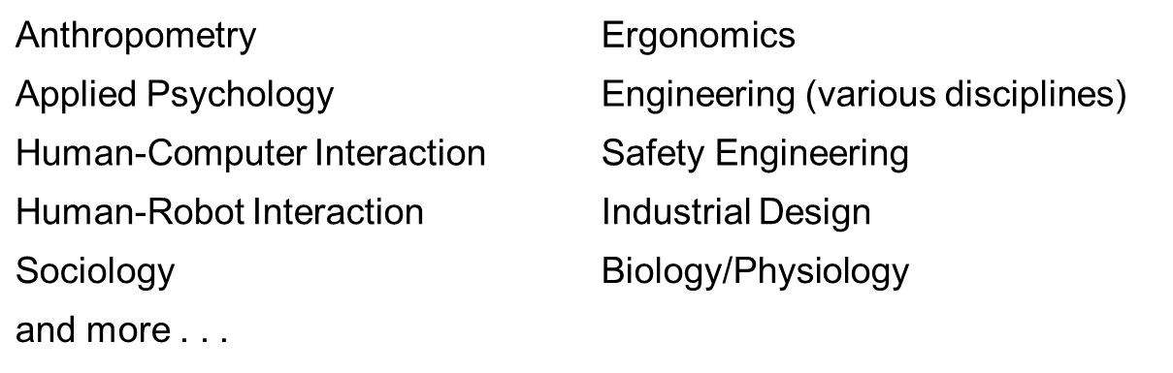
Human factors engineering?
Interdisciplinary and multidisciplinary field concerned with the interaction between people and the technical and built world around them.
Some of the topic areas covered in human factors include:

Slide 4
Human factors engineering? (cont’d)
Some areas of concern to human factors engineers:
  UI/UX engineering the user experience
  Decision making
  Product design
  Human performance
  Human movement and control of action
  Communication
  Automation
  Safety
  Human error
  Teamwork
  and more . . .
Include what we know about human behavior in the engineering development process

Slide 5
What is Human-Centered Design?
An iterative design process focused on meeting the needs, and considering the abilities and goals of the person using a product or system
  Needs: Understanding the person in her/his context.
  Abilities: What is a person able to do safely, comfortably, effectively?
  Goals: What is the person trying to do? What actions do they think
  they need to take?
  User failures with products and systems often result from a fundamental mismatch between the designer’s mental model and the user’s mental model for how the product or system works.

Slide 6
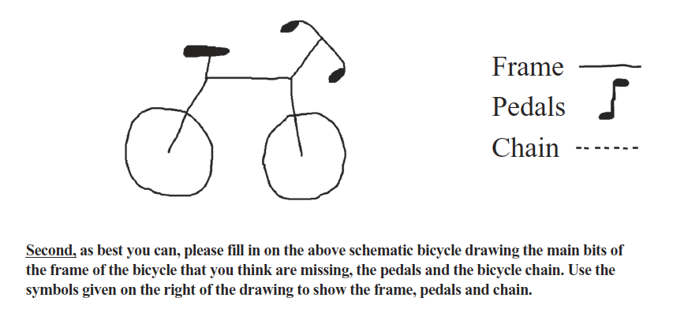
What is Human-Centered Design? (cont’d)
Lawson, R. (2006). The science of cycology: Failures to understand how everyday objects work. Memory & Cognition, 34(8), 1667-1675.

Slide 7
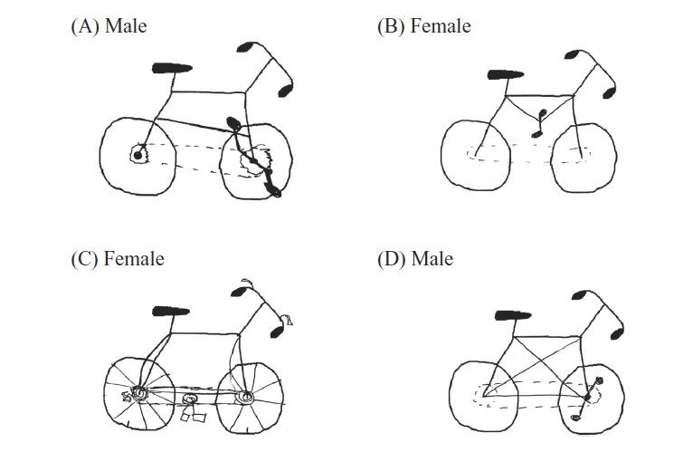
What is Human-Centered Design? (cont’d)
Demonstration:
Lawson, R. (2006). The science of cycology: Failures to understand how everyday objects work. Memory & Cognition, 34(8), 1667-1675.

Slide 8
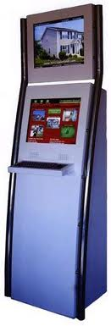
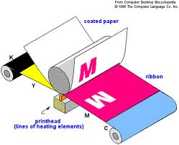
What is Human-Centered Design? (cont’d)
Lack of Human-Centered Design Led to Lack of Product Acceptance

Slide 9
Limitations of Human Performance:
Sensory & Perceptual
  Auditory
  Visual
  Attention

Slide 14
What comes next?
O T T F F S S

Slide 15
What comes next?
O T T F F S S
One
Two
Three
Four
Five
Six
Seven
Eight
Nine

Slide 16
Conducting Human-Centered Design
  Typical aspects in human-centered design:
  Identify target users/subject matter experts
  Knowledge elicitation techniques
    Observation
    Interview
    Task analysis/Cognitive task analysis
  Consider elements of human performance, and how do they accomplish their goals currently?
  Ideation and rapid prototyping
  User testing
  Design feedback

Slide 17
Conducting Human-Centered Design (cont’d)
Consider the Beliefs your user has and the Behavior that your product or system is trying to evoke or change.
  What is/are the user’s goals
  What is/are the user’s
    Beliefs about their Responsibilities
    Beliefs about their Capabilities
    Expectations for the outcome of using the product or service
It is one thing to know how a pair of scissors works, it is another to know how to use them to solve a problem.
Therefore – take the time to make the user’s mental model explicit. It is not just how it works, but how they will use it.

Slide 18
Conducting Human-Centered Design (cont’d)
Consider the Knowledge that is available about how the product or system works
  What is known generally about this product, system or domain?
  What does the user know about this domain?
  What do experts in this domain know that novices don’t know?
  How do we convey the information to the user that is needed to be successful with the product or service?
    Labeling
    Packaging
    Training
    Instructions
    “Intuitive User Design”
These elements have a direct bearing on the UI/UX design.

Slide 19
Conducting Human-Centered Design (cont’d)
Consider the Actions that the user needs to perform, keeping in mind their various limitations:
  Physical
  Sensory/Perceptual
  Cognitive
  Social/Emotional
Actions have consequences for the user
  Actions require making a decision – testing some belief, assumption, or consideration
  Actions change the world around the user and generate feedback to support or refute initial beliefs. Make the results of their actions obvious.
Rapid prototyping and iterative testing with users will help refine the product or system leading to optimal results.
https://www.youtube.com/watch?v=musmgKEPY2o

Slide 20
Exercise = 20 min
Keeping Human center design in mind, list the steps you would do to design a product and apply that to an example product of your choice.
Example products can be:
Smartphone
Intelligent Cars
Software in Cloud either using IaaS,PaaS,SaaS

